Slide 1
Project Schedule
John Song
May 27 2014

Slide 2
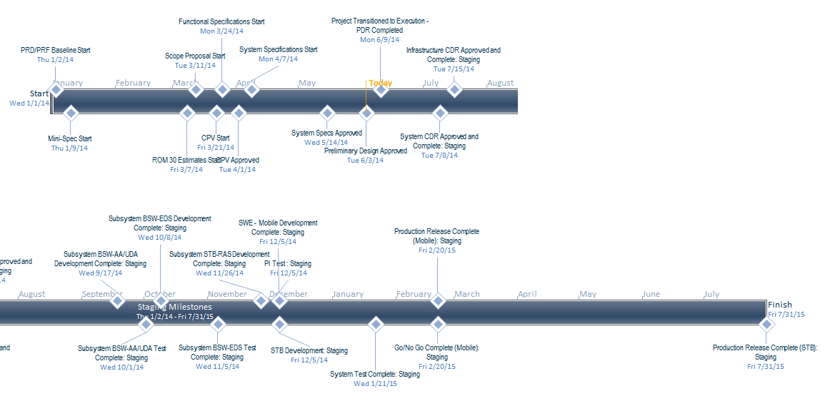
Schedule

Slide 3
Schedule
Milestone Dates:
CDR – Completed 7/8/2014
ICDs – Completed 7/22/2014 *Needed by IT
BSW – Authorization/Authentication & User Data Applications Development & Subsystem Completed 10/1/2014
BSW – EDS Completed 11/5/2014
Mobile – Development and Unit Testing Completed 12/5/2014
PI Environment – Completed 11/20 *Needed by IT for integration testing
Subsystem Testing Completed – 1/21/2015
Mobile Release – Feb 2015
STB Release (NEO) – July 2015

Slide 4
Requirements and Architecture
Rajkumar Selvaraj
May 27 2014

Slide 5
Requirements
Recommendations Near Term (2014)
What's popular (popular across all DIRECTV platforms)
Household based recommendations (personalized)
Platforms
Mobile/Dotcom using REST APIs
STB using RAS/APG
Recommendations Long Term (2015 and beyond)
Enhanced Recommendations
Sub profile based recommendations
Consistent recommendations across all platforms
Recommendation Controls
Filter Recommendation (hide items)
Explicit ratings (DEPG prefers to bring this to 2014)
Privacy – consider users “private-mode” in recommendations
Platforms
Mobile/Dotcom/Connected STB using REST APIs
Non Connected using same API, delivery using APG

Slide 6
Use Cases
What's popular (popular across all DIRECTV platforms)
Use the past popularity and apply them to 14 day Guide.
Not personalized – every user sees the same list based on popularity
Household based recommendations (Account and Master Profile Level)
Based on what you watched
Based on your taste
Generic movie recommendations
Generic TV series recommendations
Sports recommendations
Personalized – based on viewing history of a user
Platforms
Mobile/Dotcom using REST APIs
STB using RAS/APG
Response Events Report – feedback from clients in response to recommendations

Slide 7
Updates
Environments
MSDC for Development
Amazon Cloud during E2E and Production
We may have an additional CDR
if cloud details change considerably from MSDC details
Data Security clearance from IT
In progress
Dependency on VDDS / VDCS
Mitigation plan to pull AMS/DMS data from RDBMS is OK
Data has to confirm to the query/fields defined by EDS, please raise data structure changes as a risk
Data sources
CDN Manager logs to be ingested from LABC, not from IT/BI
New Ideas and Patents
If there are new solutions/improvements in this design for invention disclosure submissions
This is a ripe area for patent filings
Please Contact Snyder, Todd N <TNSnyder@DIRECTV.com>

Slide 8
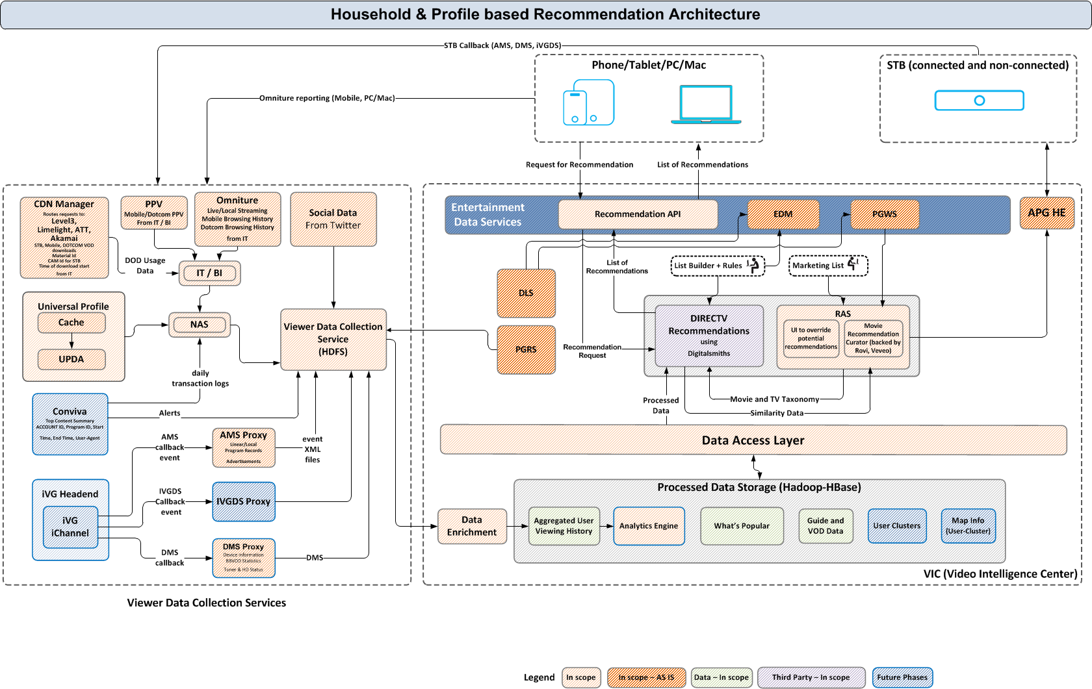
System Architecture Diagram

Slide 9
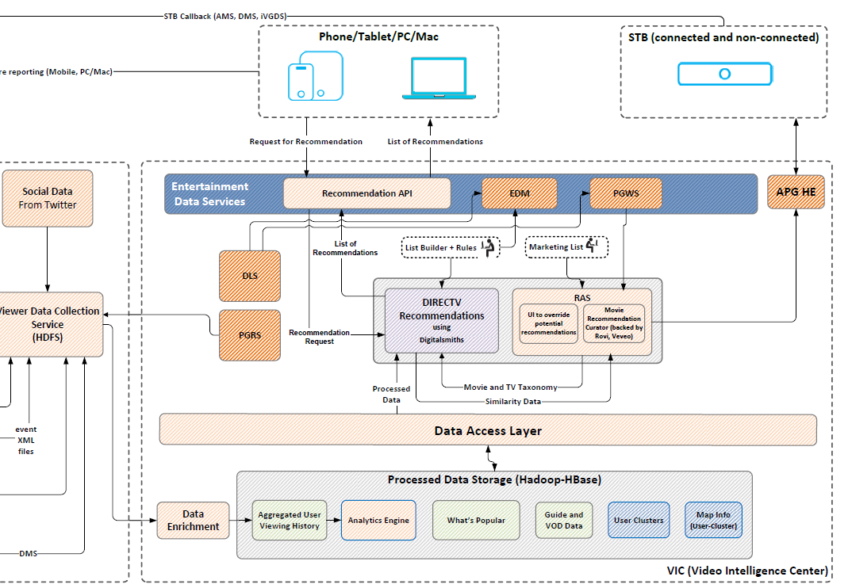
System Architecture - Client Devices
1
2

Slide 10
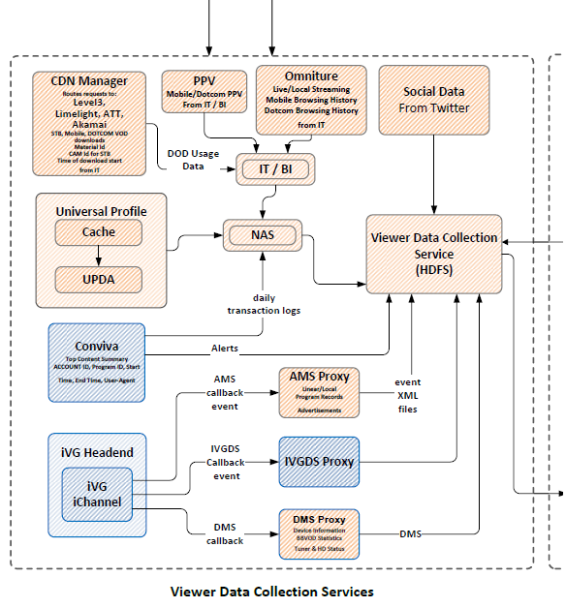
System Architecture – Data Collection
4
1
3
2

Slide 11
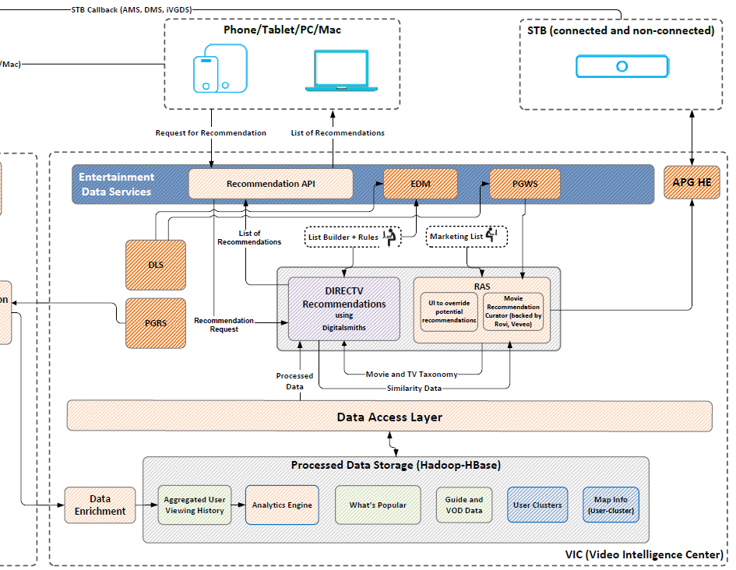
System Architecture – VIC Video Intelligence Center
4
6
5
3
1
2
7

Slide 12
Video Intelligence Center
Ashok Sahu
May 27 2014

Slide 13
Agenda
Overview
Software Architecture
Content Management & Curation
Data Aggregation
Analytics Service
Recommendation Engine
Personalization Service
Deployment Architecture
Monitoring & Control

Slide 14








Overview
With DIRECTV’s recommendation engine, customers now get more personalized content across all key points of discovery on the Apps and Dotcom
Get top suggestions just for you
Personalized similar shows
Based on what you watch or record
Because you watched…
Top Movie Picks
Get the best entertainment content selected just for you based on your overall behavior and preferences from the Entertainment homepage
Based on particular programs you watch or record, receive suggestions for similar content on movie and TV show pages
Similar shows on program pages are now personalized to you
Improves discovery
Notes:
14
14

Slide 15
How
Aggregates User viewership data from various input sources
Derive user tastes from the User Date
Utilities to create rules for content curation
Algorithms for recommendations
With DIRECTV’s recommendation engine, customers now get more personalized content across all key points of discovery on the Apps and Dotcom
Get top suggestions just for you
Personalized similar shows
Based on what you watch or record
User Data Aggregation
Because you watched…
Analytics Service
Recommendation Engine
Services for clients to interface
Top Movie Picks
Content Management (Curation)
Get the best entertainment content selected just for you based on your overall behavior and preferences from the Entertainment homepage
Based on particular programs you watch or record, receive suggestions for similar content on movie and TV show pages
Personalization Service
Similar shows on program pages are now personalized to you
Because you watched…
Improves discovery
Top Movie Picks
Notes:
15
15

Slide 16
Content Management (Curation)
Architecture
User Data Aggregation
Recommendation Engine
User Data Aggregation
Analytics Service
Analytics Service
Recommendation Engine
Content Management (Curation)
Personalization Service
Personalization Service

Slide 17
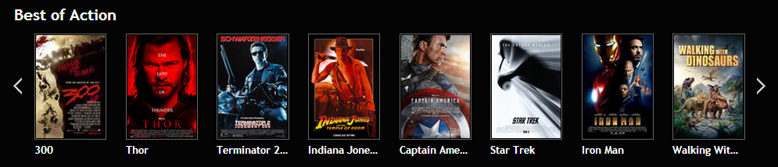
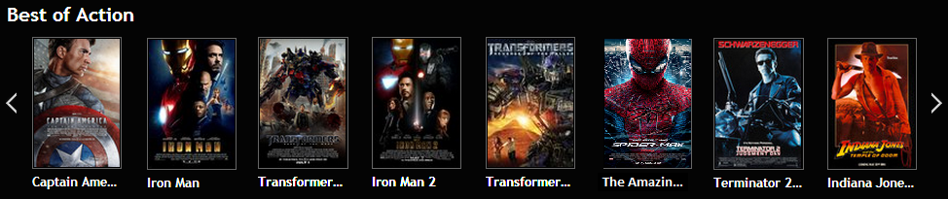



Content Management
Extends List Builder Functionality
Rules to drive Recommendation based carousels
Todays Carousel in DIRECTV.com
Personalized Carousel
Integrates with RAS console to leverage available guide metadata and search APIs.
Integrates with Digitalsmith’s Business Console.
Influence the recommendations by Boosting, Filtering and Equalizing

Slide 18
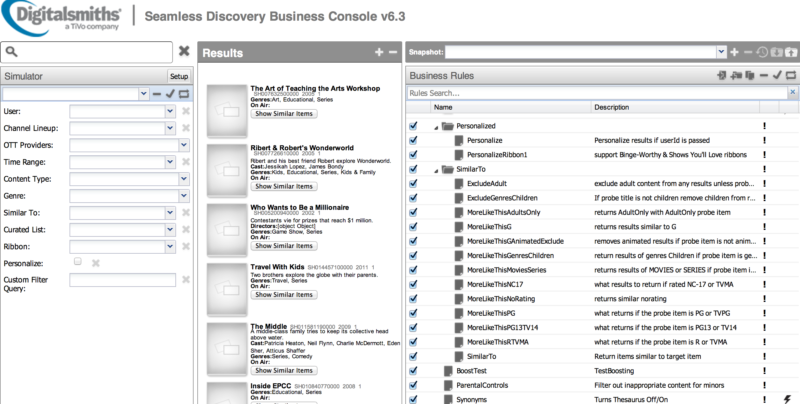
Content Management
Digitalsmith’s Business Console

Slide 19
Data Aggregation
Architecture
User Data Aggregation
Analytics Service
Recommendation Engine
Analytics Service
Recommendation Engine
Content Management (Curation)
Content Management (Curation)
Personalization Service
Personalization Service

Slide 20
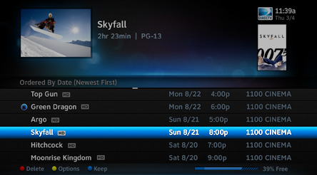
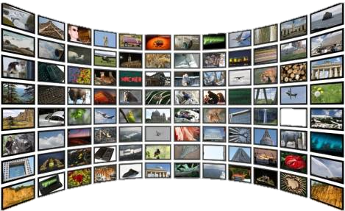
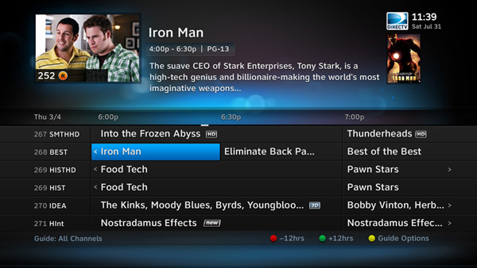







Viewership Data
Viewing History
VOD Download data
Recording & Playback
VOD Downloads
Live Viewing History
Social
User Profile

Slide 21
Data Sources
Viewership Data | Sources | Use Case
STB Live Viewing | AMS | personalized recommendation and trending
STB Streaming | UP
mobile streaming | Omniture (IT)
dotcom streaming | Omniture (IT)
purchase information | IT BI
social | Omniture (IT)
guide | PGRS | data enrichment
user profiles | UP | user profile for profile id
VOD downloads | CDN Manager | trending information

Slide 22
Data Ingestion & Processing
STB Live Viewing
User Data Aggregation
STB Streaming
Mobile Streaming
User Viewing History
Dotcom Streaming
Purchase History
Social
User Profile
Guide (Program, Schedule, Channels)
VOD Downloads
Program Guide

Slide 23
AMS and Guide data Ingestion
Goal: Find live view programs watched by users on the STB
AMS Data Ingestion
Detect live view, recording and playback events
Aggregate events between event start time to detect start and end time for an event
Guide Data Ingestion
Ingest DLS full file and write into the following tables on HDFS
Channels, schedule and program
Denormailize guide data to store schedules, channel and programs by minute.
Find distinct tmsid and total viewed duration of a program joining AMS and denormalized guide data
starttime | endtime | duration | channelid | tmsid
201405261100 | 201405261101 | 1 min | 1938 | EP013520840001

Slide 24
IT/Omniture Data Ingestion
Goal: Understand user’s purchase, streaming and social behavior
PPV Data Ingestion
IT data source for purchases made by Directv customer
Enriched with guide data to find missing TMS id.
Map event codes to guide data
Streaming Data Ingestion
Omniture data source to view streaming information on mobile and dotcom.
Data is enriched with TMS ID at source.
Social
Facebook “Like” events posted by users on dotcom.
Data is enriched with TMS IDat source.

Slide 25
Data Ingestion Resource Usage
Data Ingestion | CPU Intensive | I/O Intensive | Data Volume | Process Type
Guide Data | ✖ | ✔ | 4 GB | Batch
AMS | ✖ | ✔ | 50 GB | Batch
Omniture (streaming/social) | ✖ | ✔ | 4 GB | Batch
Social | ✖ | ✖ | 1 MB | Batch
UP | ✖ | ✔ | NA | Batch
PPV | ✖ | ✔ | 1 GB | Batch
Recommendation logs | ✖ | ✔ | 10 GB | Batch

Slide 26
Analytics Service
Architecture
User Data Aggregation
Recommendation Engine
User Data Aggregation
Analytics Service
Recommendation Engine
Content Management (Curation)
Content Management (Curation)
Personalization Service
Personalization Service

Slide 27
User Taste
Based on the Viewing History Data
Categorized by Genre for Movies, TV and Sports

Slide 28



Last Action
Last Watched
Last Recorded
Last Rated
Last Purchased
Last Action recorded by User
Last watched, last recorded, last purchased, last rated
For every genre, user taste, day of week and Date
Based on the Viewing History Data

Slide 29


What’s Hot
Draw carousels based on what’s trending on Directv
Source: User’s viewing history and CDN downloads
Buzz model to find trending content.

Slide 30
Analytics Resource Usage
Analytics | CPU Intensive | I/O Intensive | Data Volume | Process Type | Comment
Acctid – Encrypted id mapping | LOW | ✔ | 50 GB | Batch | Mapping is required for RS to call DS with encrypted id
Last Action | HIGH | ✔ | 50-60 GB | Batch | Derive users events, such as last watched, last purchased etc
User Taste | HIGH | ✔ | 50-60 GB | Batch | Calculate and aggregate users viewing patterns
Posting Events and Guide to DS | LOW | ✔ | 50-60 GB | Batch | Post view events and Guide data to DS

Slide 31
Recommendation Service
Architecture
User Data Aggregation
User Data Aggregation
Analytics Service
Analytics Service
Recommendation Engine
Content Management (Curation)
Content Management (Curation)
Personalization Service
Personalization Service

Slide 32
Recommendation Engine
Algorithms that perform the actual recommendation.
Business console allows creation of rules based on the function groups: Boosting, Filtering, and Equalizers.
RAS handles the “Genie Recommends” curated list and formats the data ready for satellite transmission.
Recommendation Engine
Digitalsmiths
Bus. Console
Recommendation Authoring System (RAS)

Slide 33
Personalization Service
Architecture
User Data Aggregation
Recommendation Engine
User Data Aggregation
Analytics Service
Analytics Service
Recommendation Engine
Content Management (Curation)
Content Management (Curation)
Personalization Service

Slide 34
Recommendation Services (RS) Architecture
Data Services Layer
APIs interfacing with recommendation, analytics and guide services
Fetch personalized recommendation and merge with guide to reduce chattiness
Experience Based API
Based on concept of “componentization of services”
APIs specific to client implementation.
Aggregate core API to drive recommendation carousels
Proxy layer built on Varnish Cache
Reverse proxy for downstream systems
Caching as defined by the HTTP 1.1.
Log API metrics and SLAs
Clients
(dotcom, mobile, STB)
Proxy Layer
( auth., caching, logging & API metrics )
Experience based API
(API aggregation, client specific implementations)
Data Services Layer
Analytics Engine
Guide/PGES
Recommendation Engine

Slide 35
Deployment
User Data Aggregation
Recommendation Engine
User Data Aggregation
Analytics Service
Analytics Service
Recommendation Engine
Content Management (Curation)
Content Management (Curation)
Personalization Service

Slide 36

Deployment Architecture
(POPs)
RS REST
PGES REST
near real time
UP REST
Recommendation Engine
Recommendation
via API
Digitalsmiths
DTV Customization & Blending Rules
EDM REST
Bus. Console
PGRS Service
LA
VA
CR
Batch Process
upload schedule &
metadata to AWS S3 bucket
Post User View Events
via API
analytics via API
Batch Process
curation rules
& lists via netapp
HDFS & HBase Infrastructure
Viewer Data Aggregation
Aggregated Personalized Data
scp
files
DLS
PGRS
Content
Curation
Metadata Aggregation
AMAZON/DTV
LABC
VDCS
VDCS
VDDS
scp omniture, ppv data
IT Systems

Slide 37
Monitoring
User Data Aggregation
Recommendation Engine
User Data Aggregation
Analytics Service
Analytics Service
Recommendation Engine
Content Management (Curation)
Content Management (Curation)
Personalization Service

Slide 38
Monitoring and Control
GSDM shall be used to monitor recommendation platform
API and analytics logs shall be ingested by Splunk to improve monitoring
GSDM shall interface with DMACS to provide alerts to Ops
Wiki page shall be created to document the logs and error conditions.
Ops can interface with development using the wiki

Slide 39
Big Data Platform – Reference Architecture
Bala Esakkinathan
May 27 2014

Slide 40
Agenda
VDCS/VDDS: Product Goals
Viewer Data: Functional Domain
Architecture: Collection & Distribution

Slide 41
Viewer Data – Product Goals
Data Ingestion
To build a system that accommodates high velocity, different variety, high volume viewer data collection
Storage
To build a system that stores all viewer data in a highly available, scalable, reliable, secure and flexible distributed environment
Computation
To build a system that can quickly process large viewer data sets
Data Distribution
To build a ‘low –latency’ data serving system that feeds business intelligence
Easy Integration
To build a system that can be easily integrated on AMP and with BIAS, external and internal DIRECTV applications

Slide 42
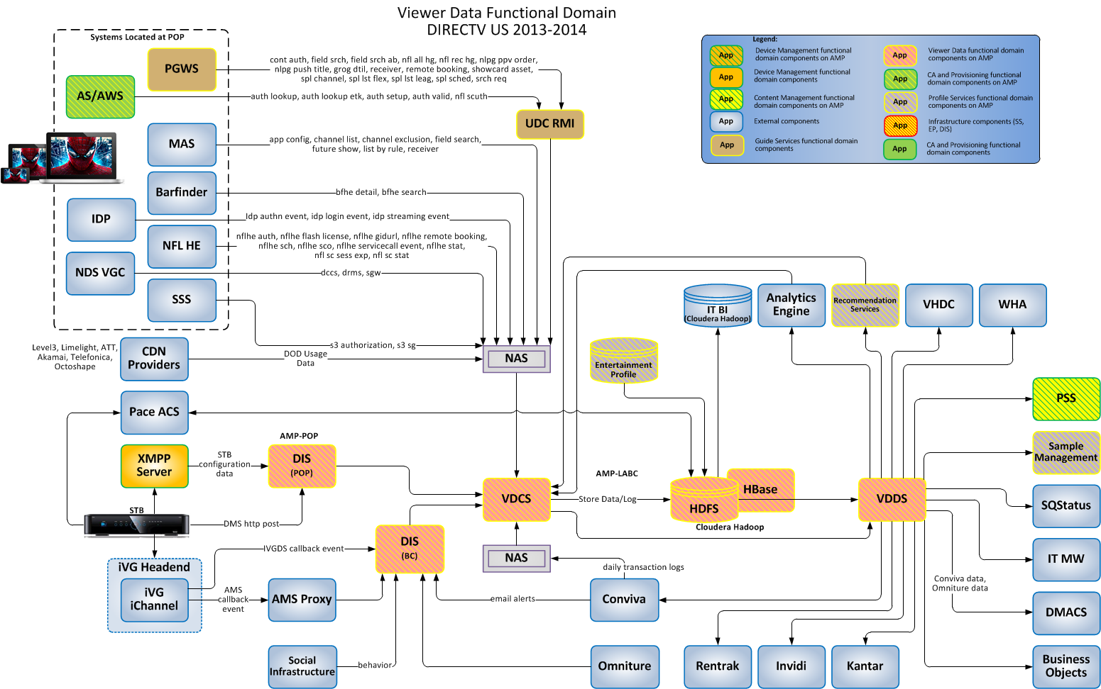
Viewer Data - Functional Domain

Slide 43
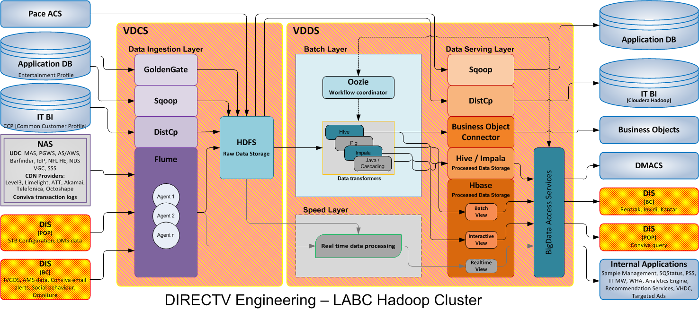
Viewer Data – Collection & Distribution

Slide 44
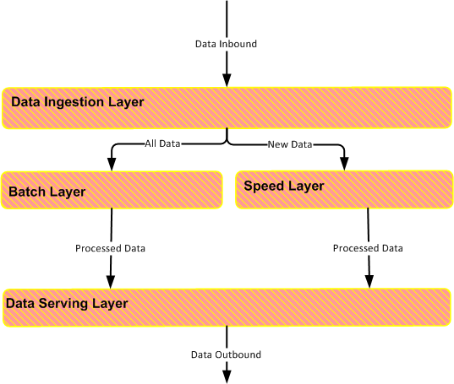
VDCS / VDDS – Layered Architecture
VDCS / VDDS is composed of 4 layers
Data Ingestion Layer
Batch Layer
Speed Layer
Data Serving Layer

Slide 45
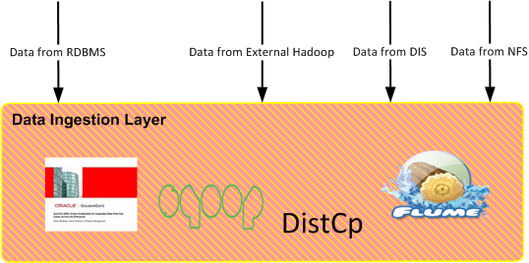
VDCS / VDDS – Data Ingestion Layer
Responsible to collect data in HDFS from following sources
External RDBMS [Using OracleGG , Sqoop]
External Hadoop clusters [Using DistCp]
Network File storage devices [Using Flume]
Data integration services [Using Flume]

Slide 46
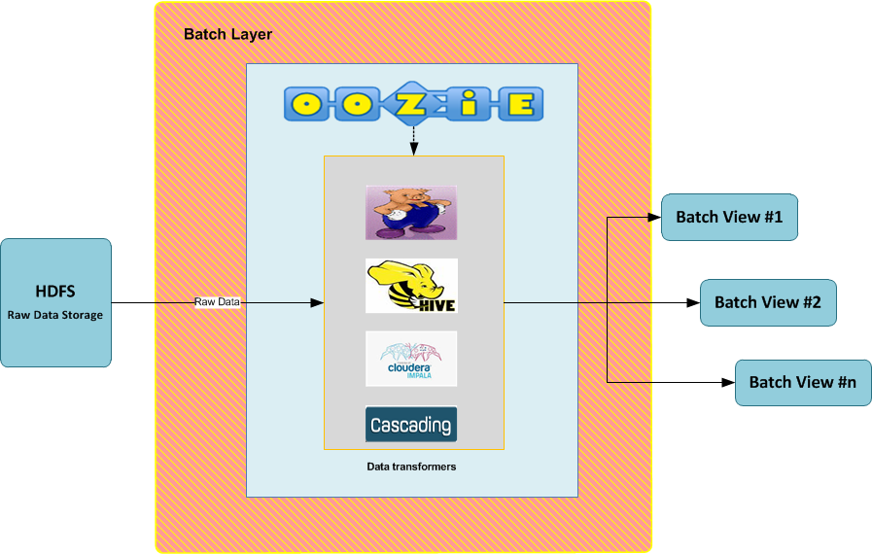
VDCS / VDDS – Batch Layer
Stores raw dataset
Unrestrained data processing
Data processing based on immutable data inputs is idempotent
Map Reduce (MR) jobs using Pig, Hive, Impala or Java / Cascading to process raw data. MR jobs create views in Hbase
Has ‘Oozie As A Service’ to coordinate MR jobs

Slide 47
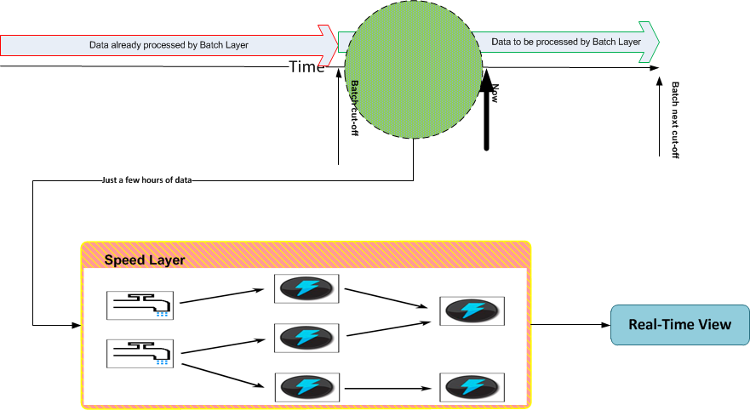
VDCS / VDDS – Speed Layer
Stores a limited window of data
Continuous computation
Complex event processing logic resides in speed layer
Highly scalable
Data is in motion

Slide 48
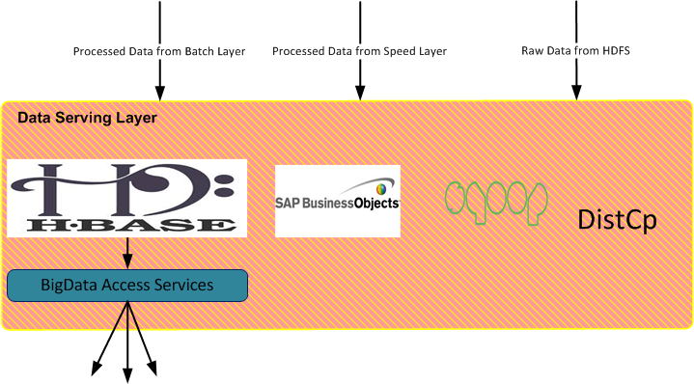
VDCS / VDDS – Data Serving Layer
Holds processed data in Hbase
Supports multiple processed data views: batch view, real time view and interactive view
Custom BigData Access Services are responsible for data aggregation
Tools like BO-Hive Connectivity, Sqoop, DistCp used to serve data

Slide 49
Audience Measurement System (AMS) – VDDS/VDCS
Evelyn Nobuhara
5/4/2014

Slide 50
Project Goals
Scope
Migrate and simplify design of current AMS collection/distribution functions
Scalability
AMP - Service Oriented Architecture
Hadoop - Big Data Solution
Performance
Improve volume/performance of AMS data collection
Current: 6+M
Ramp up: 16M
Improve performance of AMS hourly and daily jobs
Services for access of AMS data
Recommendations
Sample Management System
IT/BI
Business Objects

Slide 51
Legacy AMS Components
AMSDS - collection of event posts from upstream systems
STB logs transformed into XML by AMSProxy.
XML is posted to AMSDS which parses out and stores events in addition to STB header info into AMSDS database.
Destination data is aggregated into hourly event, ams calls, adn/non-adn files which are available to third-parties for analysis.
AMSDP – diagnostic/failure events stored in AMSDP database
AMSIT/AMSSMWS – add/remove cards for third parties
AMSSM – sample management
Daily job for eligible cards for inclusion/exclusion to destinations
Data enrichment
Sample definition
Card destination management
AMSSMWeb - web-based front-end for AMS sample and destination management.

Slide 52
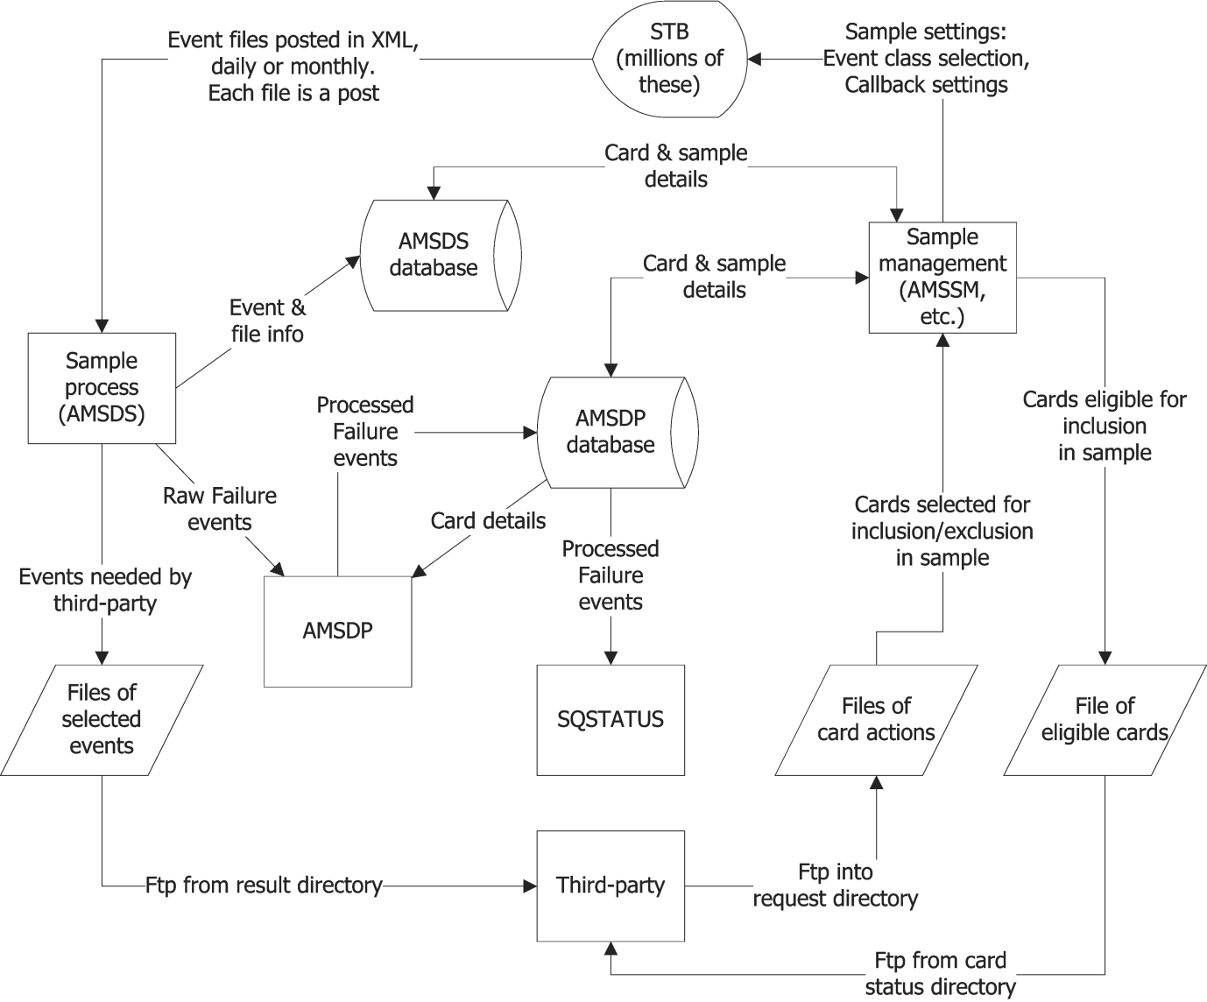
Current AMS High Level Design

Slide 53
AMProxy XML for AMS Events
New AMS Log: Sat Jan 26 00:00:01 GMT 2013
<?xml version="1.0" encoding="UTF-8"?>
<AMSSubscriberLog xmlns:xsi="http://www.w3.org/2001/XMLSchema-instance" CardID="240892844" ClientID="1" DocumentCreationDate="2013-01-26T00:00:01" DocumentVersion="8" EventClassID="2047" STBLogCreationDate="2013-01-25T13:43:33" SampleID="3" xsi:noNamespaceSchemaLocation="/opt/dtv/apache-tomcat-5.5.26/ams_proxy/webapps/ams_proxy_dtv/WEB-INF/AmsXmlSchema_3.4.2.xsd">
<Event EventTime="2013-01-25T13:43:51">
<LiveViewEvent>
<Channel channelObjectId="4306692">
<Stream streamId="4112“ streamType="Video"/>
<Stream streamId="4114" streamType="Audio"/>
<Stream streamId="65535" streamType="Data"/>
</Channel>
</LiveViewEvent>
</Event>

Slide 54
AMSProxy XML for AMS Events
<Event EventTime="2013-01-25T15:33:19">
<PlaybackEvent>
<PlaybackProgram eventSource="Playback" recordedTime="2012-12-14T02:00:00" speed="0">
<Channel channelObjectId="3473824"/>
</PlaybackProgram>
</PlaybackEvent>
</Event>
<Event EventTime="2013-01-25T16:30:29">
<SignalFailureEvent>
<SignalFailures channelObjectId="4306692" transponderId="101" tunerId="0"/>
</SignalFailureEvent>
</Event>
<Event EventTime="2013-01-25T23:59:45">
<EndOfFileEvent />
</Event>
</AMSSubscriberLog>

Slide 55
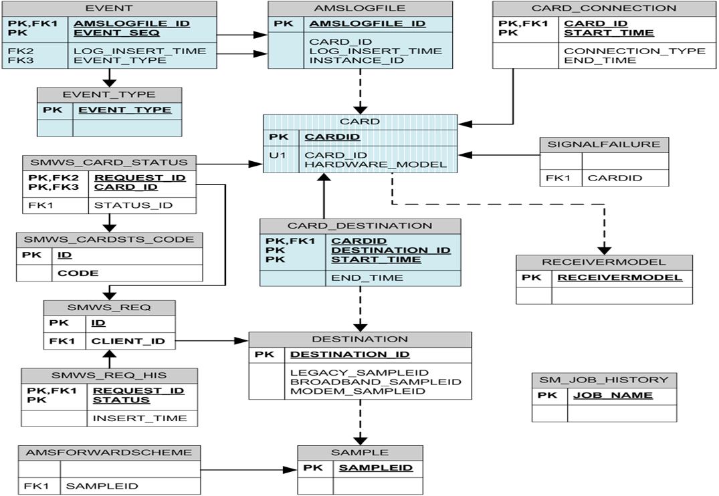
AMS Oracle Tables

Slide 56
AMP and Big Data Solution
Viewer Data Collection System for AMS
Merge AMSDS and AMSDP to collect all events including diagnostic/failure events
Viewer Data Distribution System for AMS
Enrich data and generate eligible cards for Kantar, Rentrak, Invidi, DRE
Aggregate hourly event data files for analysis by Kantar, Rentrak, Invidi, DRE
Provide data services to clients i.e. Recommendations, Sample Management Service, IT/BI, Business Objects, etc.
Data sources: HDFS (AMS/ACCOUNT/DMS/GUIDE/CADS)

Slide 57
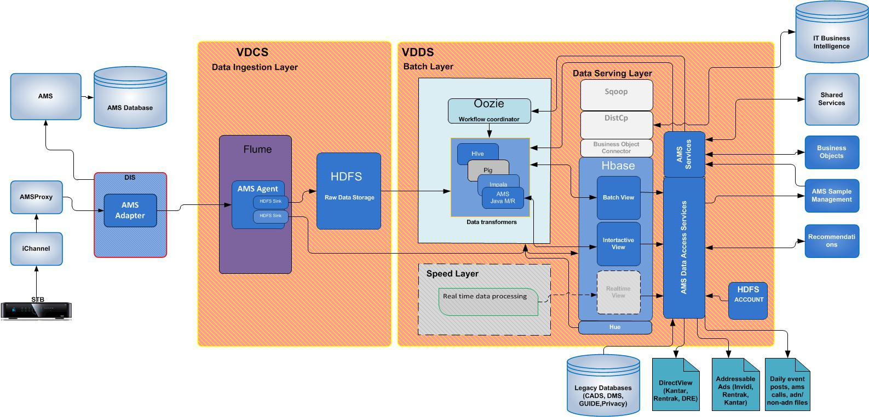
AMS High Level Design

Slide 58
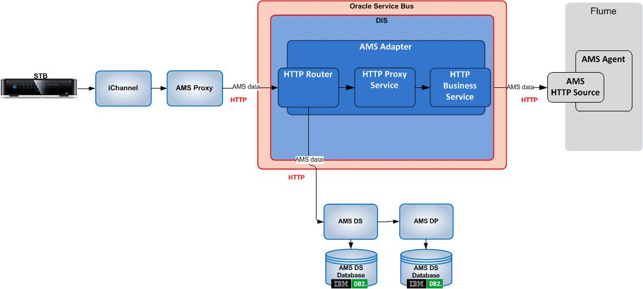
VDCS – DIS AMS Adapter

Slide 59
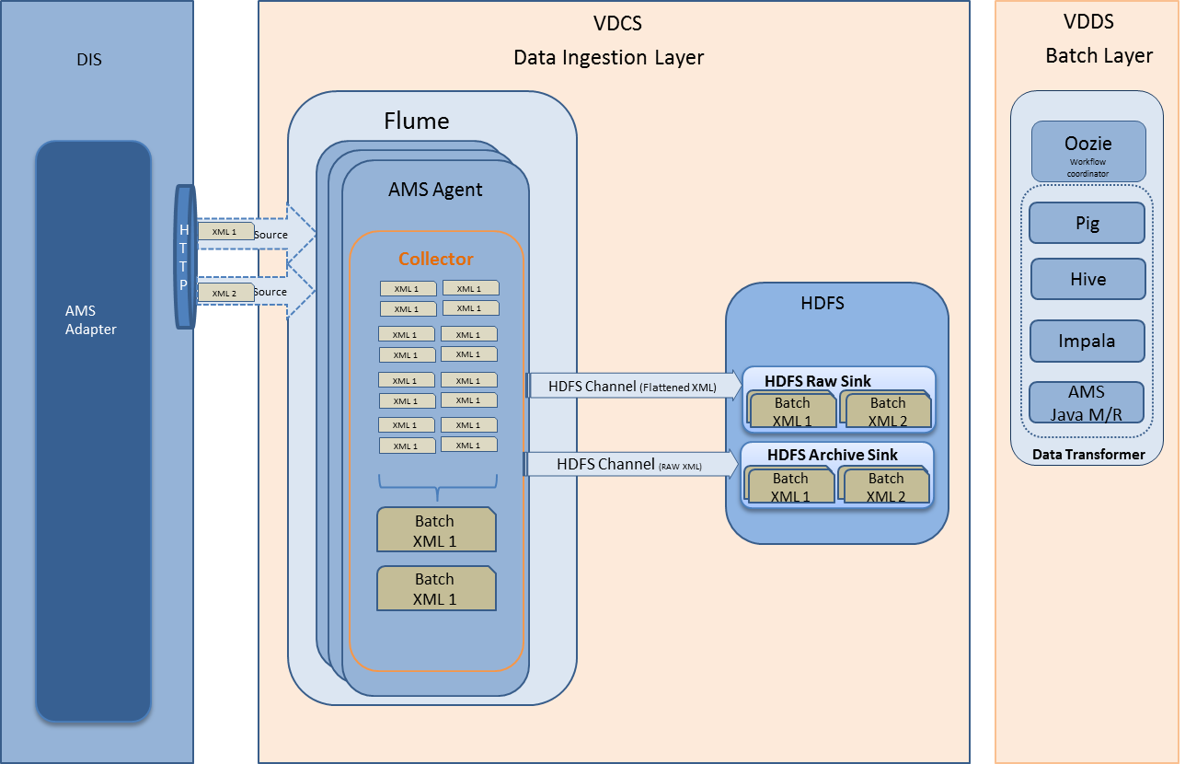
VDCS - AMS Data Collection

Slide 60
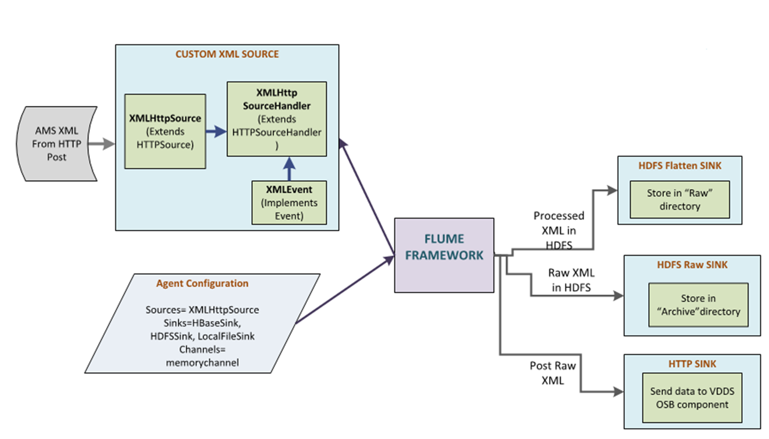
VDCS - AMS Data Collection

Slide 61
Data Ingestion Layerayer
Flume ingestion
DIS will forward HTTP posts to Flume AMS agents
XMLHTTPSource will be used to process HTTP post requests
For performance, multiple instances of AMS Agents will be hosted across multiple nodes and will use a common collector.
Three channels will be created for different data sinks (2 HDFS, 1 HTTP)
Agent will be configured based on channel requirements
File based channels will be used for durable messages
HDFS Sink
Custom HDFS sink will be used to store batched raw data XMLs in “archived” directory
Flattened events will be stored in ‘raw’ directory which will be partitioned by log insert time. The folder structure used will partition data by date, and that date can be configured as log insert time.
HTTP Sink
Custom Http Sink will post HTTP requests to VDDS OSB component

Slide 62
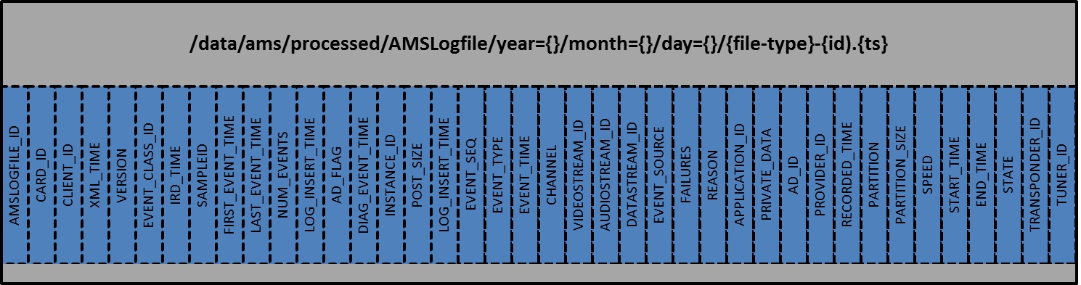
HDFS for AMSLogEvent Data

Slide 63
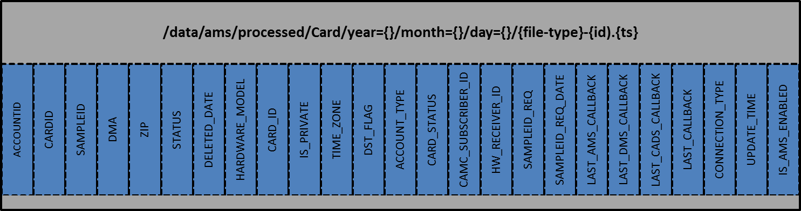
HDFS for Card

Slide 64
Migration of Account Database
Source is UPDA which gets data from IT
Data is migrated from file dump extract
JSON format into HDFS tables

Slide 65
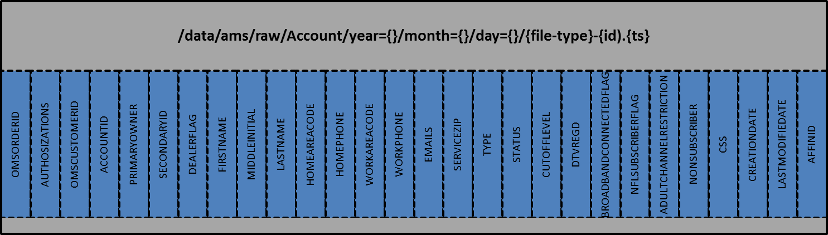
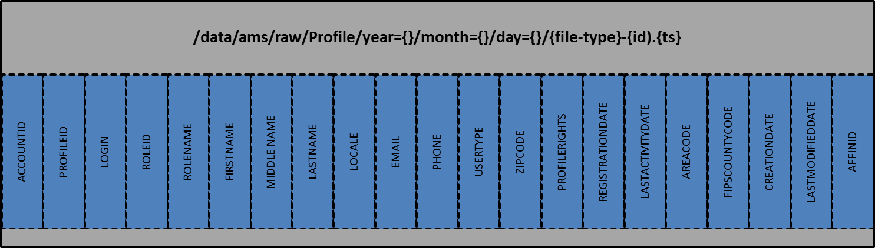
HDFS for Account/Profile

Slide 66
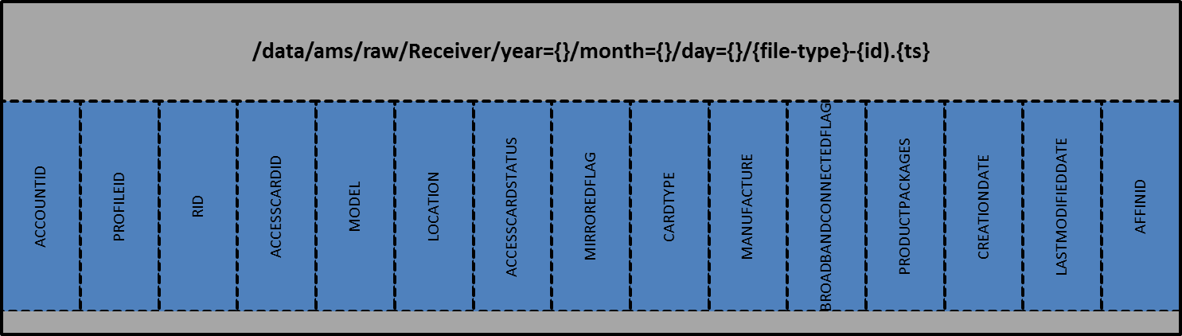
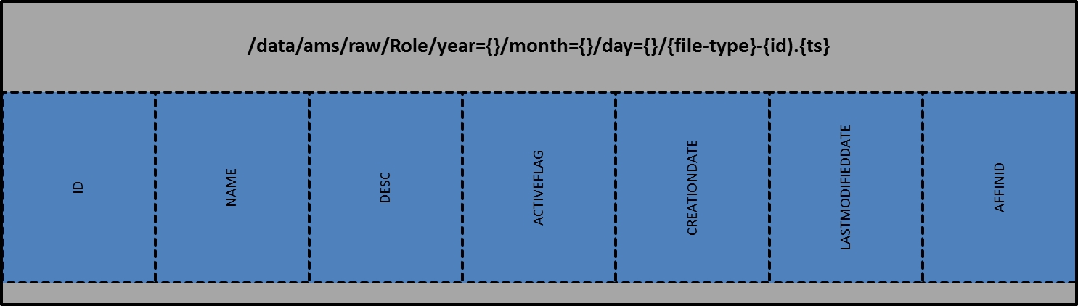
HDFS for Receiver/Role

Slide 67
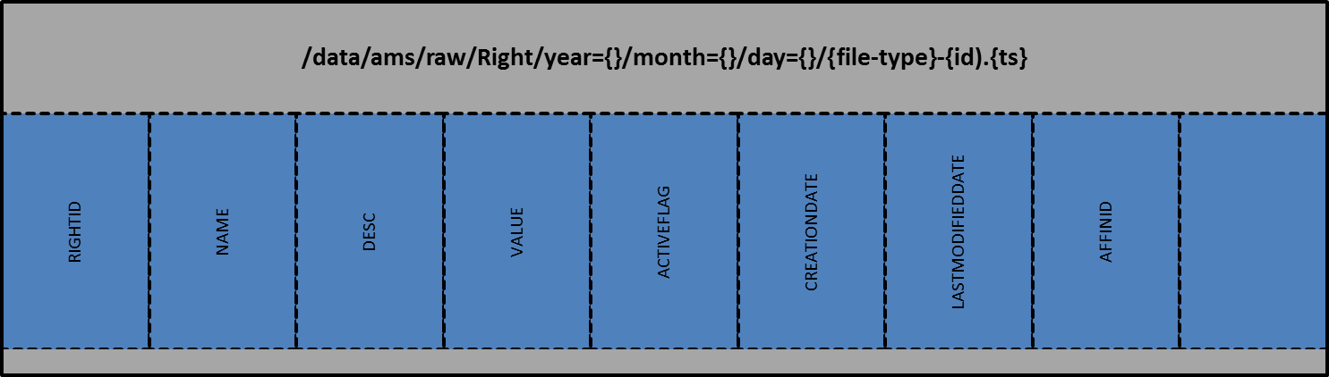
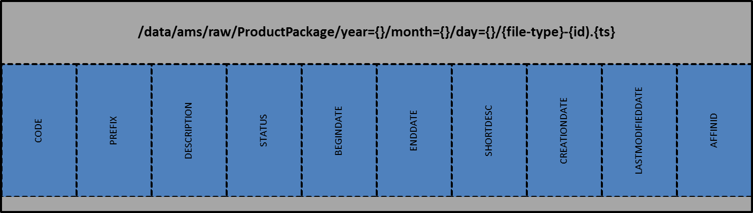
HDFS for Right/ProductPackage

Slide 68
VDDS - AMS Data Distribution
AMS Jobs will generate aggregated files in real time
Event post file
AMS call file
Adn file
Non-adn file
Daily job will generate eligible cards
DirectView: Kantar, Rentrak, DRE
AddressableAds: Kantar, Rentrak, Invidi
Vendor concurrency is supported for all reports
Data services
Recommendations
Sample Management System
IT/BI
Business Objects

Slide 69
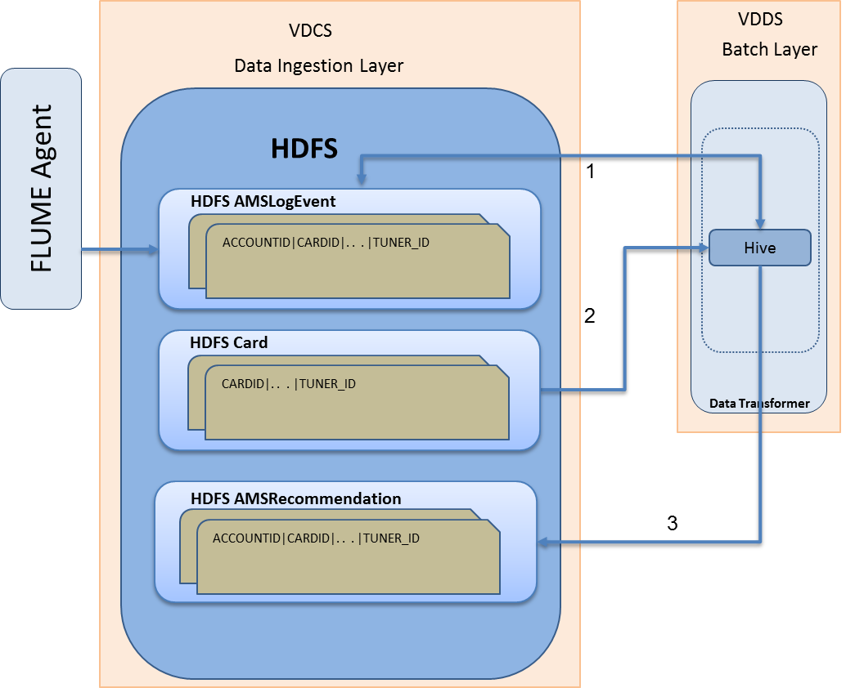
High Level Design: Recommendations

Slide 70
VDDS Service for Recommendations
Recommendations Project
Data access service – Rest or Web Service
API – getRecommendations()
Request parameters: None
Response: HDFS table for recommendations extract
Process
Access partitioned tables of AMSLogEvent data using Map-Reduce
Store results in a HDFS table
Columns of HDFS table come from the column list of recommendations SQL against current AMS

Slide 71
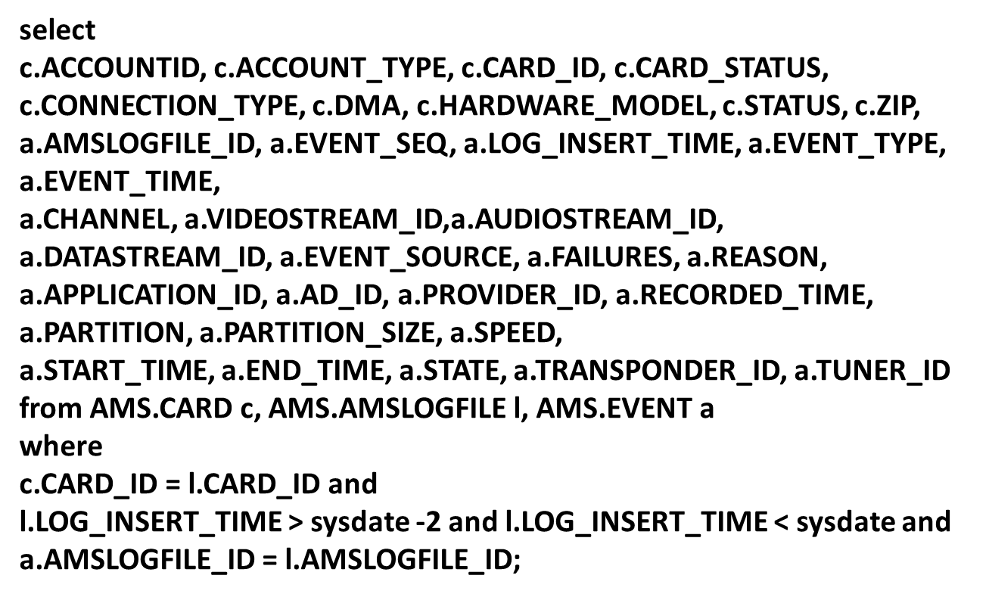
Recommendations SQL

Slide 72
RAS Overview
Brad Rice
May 27 2014

Slide 73
RAS Overview
RAS provides Series to be recorded for Genie Recommends.
Genie Recommends monitors the Series watched and records then recommends Series the viewer might be interested in.
RAS provides the data to the STB in a Graphics Object.
RAS GO Data:
Editorial list of Series to recommend.
Some Series can be selected as Mandatory and recorded on every STB.
Each Series in the Editorial List has a list of Schedule times and a list of recommender Series with Weights.
The RAS Web application provides an interface to the Producer in New York allowing them to Select Series, Make some Mandatory and order the series.

Slide 74
RAS Overview
RAS gets it’s source DATA from:
PGWS – provides two week guide information
MAD – VTAP file with related series information.
Nielsen Rating file – Uploaded by the Producer.
Input from Producer in Web Application (setting Mandatory Series, or reordering and selecting series).
RAS sends the Resulting GO file to the Head End system in the Stream Copy format.
RAS also sends the resulting GO and analysis spread sheets via E-Mail to a mailing list.

Slide 75
RAS Diagram
PGWS
Provides two week guide
RAS
Web
Application
Producer
MAD
Provides VTAP data
E-mail via
SMTP
Head End
Receives GO

Slide 76

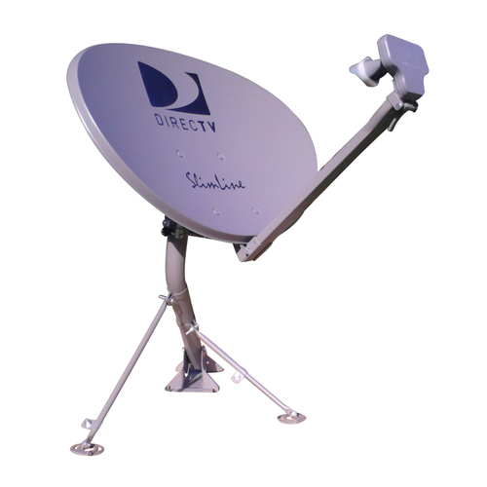

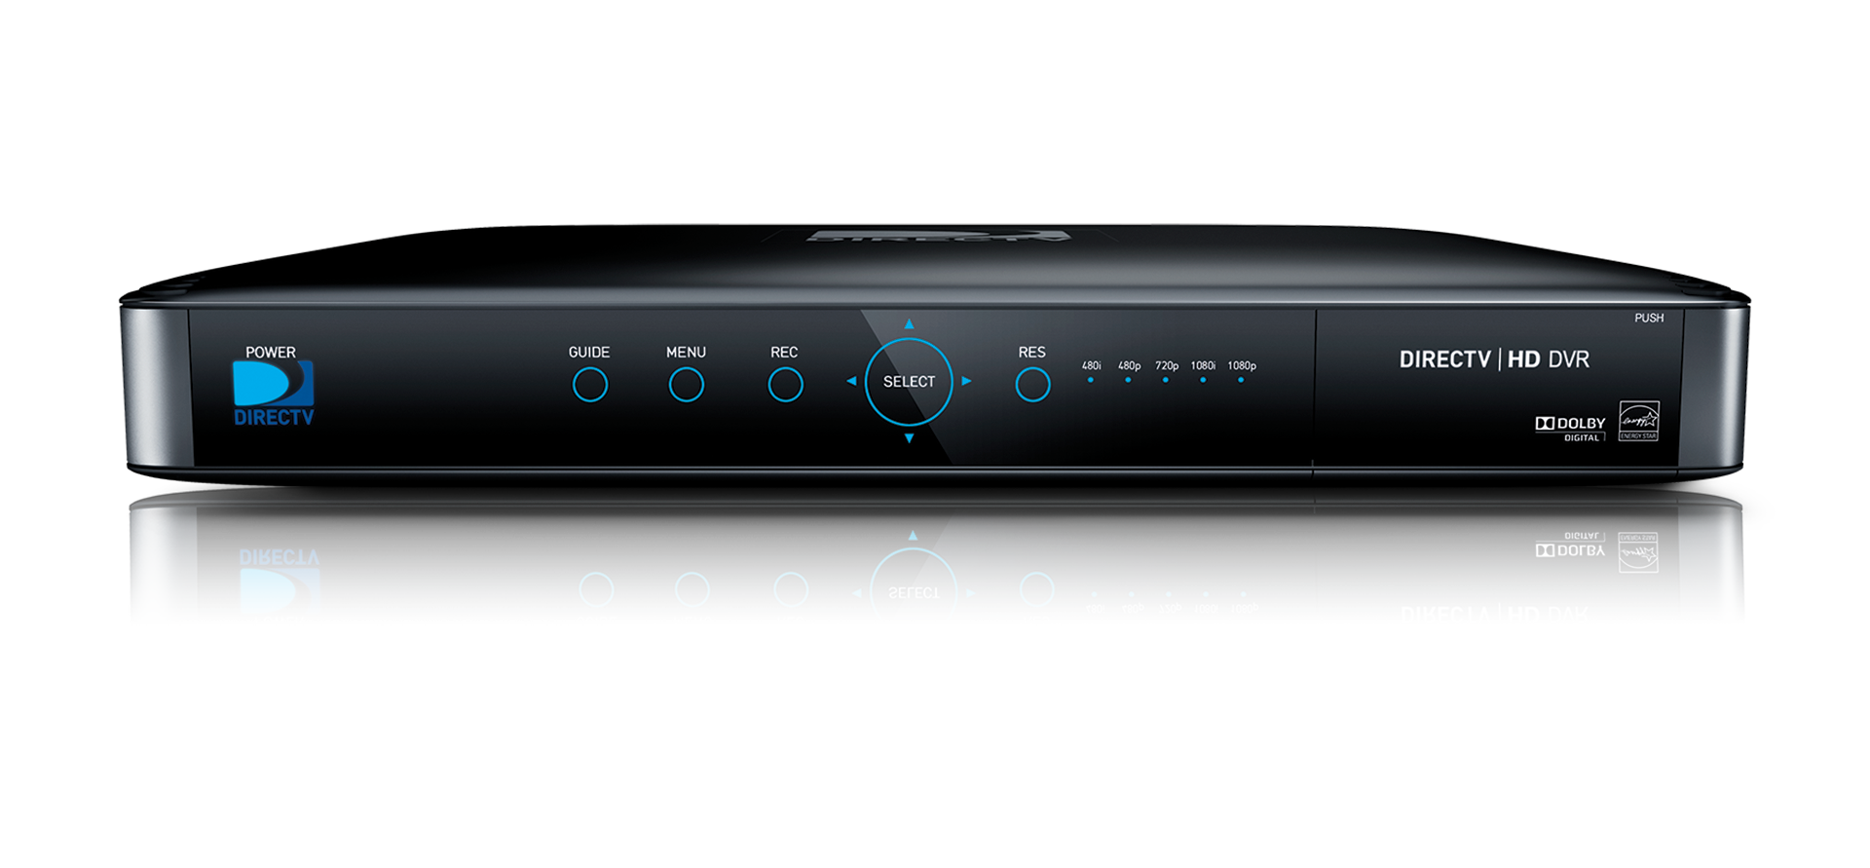

RAS Diagram
RAS
Web
Application
Head End
Receives GO

Slide 77
STB Genie Enhancement
Luke Crook
May 27 2014

Slide 78
2014 Genie Enhancement Features
Personalized Genie Movie Pull
Record titles from nonlinear channels
Record movies for Genie
Personalized Genie movies
User feedback to movie recommendation via ‘Drop from Genie’
‘What’s On’ in MYDIRECTV
Live sport specified by user’s ‘My Team’
‘Genie Recommends’ in MYDIRECTV
Order Genie recordings sensitive to client/timeslot

Slide 79
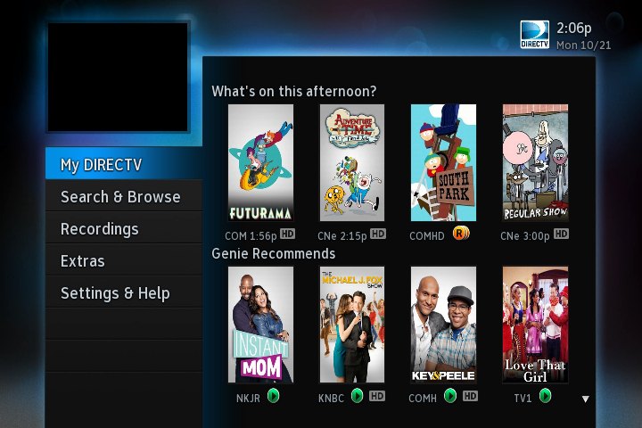

My DIRECTV
Live user ‘My Team’ sport programs
Personalized display for clients and time of day.

Slide 80
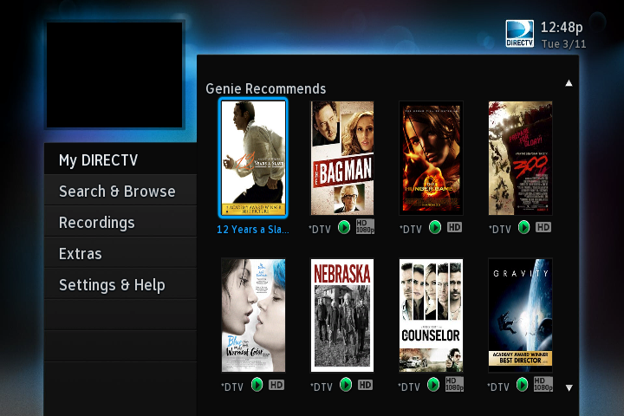
Personalized Movies
Personalized Genie movie from carousel

Slide 81
Mobile Clients (Phones & Tablets)
Ruth Yakubu
May 27 2014

Slide 82
Mobile Client
Devices
IPad, iPhone, Android Phone, Android Tablet
New Features
Carousel of recommended content is added on Homepage
Users can sort programs by recommended for them
Indicator in guide shows recommended programs
Users can filter by suggested programs
Carousel of similar shows at the bottom of Program pages

Slide 83
Mobile Client Architecture
UP
Central Cache
UPDS/UPAS
Profile content, Pause/Resume,
GVH, Opt-IN/OUT notification
UP data sync
Client
devices
Guide, Program data,
recommendation
indicator/sorting
PGWS
Omniture data:
eVar, props
ADOBE SERVER
Carousel content, personalized data
1X pixel
Data
Warehouse
web beacon
Custom reports
(NOT real-time – 1 day behind)
Raw data
Recommendation Services
Normalize
Site
Catalyst
Standard Recommendation
reports
(REAL-time – 2hrs behind)

Slide 84
E2E System Testing
Barbara Covey
May 27 2014

Slide 85
E2E Test Goals and Steps
Functional System Testing:
Goals:
Verify all components perform as a whole system as expected
Validate requirements as documented in the System Spec
Steps:
Test Planning – identify use cases, write test plan
Test Execution – perform integration and formal testing activities
Test Report Review – Review findings and test report with entire group
Test Procedures – document all the test cases and results

Slide 86
E2E Test Environment
E2E is a scaled down version of the production environment, the scalability factor between the two environments will be determined with help from SE and NSA teams.
E2E will be enhanced for Recommendations to include the following new components:
Digital Smiths
RAS

Slide 87
E2E Test Environment
The following existing components will be upgraded as necessary to run the required for Recommendations versions:
iOS – phone or tablet
Android – phone or tablet
Dotcom
DIRECTV Set Top Boxes
Connected
Not connected
VDCS/VDDS
AMS
DMS
IT/BI

Slide 88
E2E Test Use Case
All Use Cases are addressed only Recommendations 2014 requirements.
What's popular (popular across all DIRECTV platforms)
Use the past popularity and apply them to 14 day Guide.
Household based recommendations (Account and Master Profile Level)
Based on what you watched
Based on your taste
Generic movie recommendations
Generic TV series recommendations
Sports recommendations
Number of movies, TV series and Sports curations
Platforms
Mobile/Dotcom using REST APIs
STB using RAS/APG
Response Events Report – feedback from clients in response to recommendations

Slide 89
E2E Test Dates
Software Integration:
TBD
Lab System Test:
TBD

Slide 90
E2E Performance Testing
Jeff Ohrstrom
May 27 2014

Slide 91
Performance Testing Goals & Objectives
Key Objectives and Goals of Performance Testing:
The primary objective of this test effort is to evaluate performance of the Recommendations system under heavy load.
Evaluate if the changes in this year’s release and added functionality have not degraded the overall performance of Recommendations.
Analyze the resource utilization and identify any in-consistencies during load/performance test executions and report them to the project team.
Prepare the detailed Performance Test reports which will provide inputs to the NSA, DEV and Ops teams to determine the production load capacity for the project.

Slide 92
Performance Testing Details
Performance Testing Includes:
Load Testing
Stress Testing
Scalability Testing
Endurance Testing
Performance Test Activities :
Test Planning- Identify the key business transactions/use cases, write test plan, work with SE and analyze capacity requirements, scalability factor. Develop Load test scripts.
Test Execution- Execute the load, stress, scalability and endurance testing.
Test Report Review – Report issues and review findings with entire group.
Performance Test Metrics
Average Response Time
Average TPS
Failure Rate %
CPU, Memory utilization for client facing HE components

Slide 93
E2E Test Environment
E2E is a scaled down version of the Production environment, the scalability factor between the two environments will be determined with help from SE and NSA teams.
The existing components will be upgraded as necessary to run the Recommendations performance test scenarios.
The E2E lab will have some connectivity with DigitalSmiths.
Lab has dependency on applications outside the scope of this project.

Slide 94
Scenarios
Recommendations API
Clients hit this service requesting a list of recommendations.
Virtual clients will emulate DOTCOM and Mobile clients.
Determine the performance of all layers of AMP and the Cache.
Data Processing
A Hadoop cron job that feeds Digital Smiths with data.
Consumes various sources for data. Not all sources may be applicable to virtualized clients, will require further scoping.
AMS/DMS
PPV
Streaming and Remote Booking
VDC View Data
Universal Profile
Requires Digital Smiths integration in the lab, or at least sufficient stubbing.

Slide 95
Details on Data Processing Scenario
Preparation
Data, Data, and some more Data.
Data will be pumped into various systems as it would in production so that the cron job has as much varied data as possible.
As many client types as possible should be virtualized
Example may be excluding PPV data because we can’t virtualize the purchasing titles.
Need to investigate what all is possible to virtualize in the lab.
Data modeling
Test account A likes action titles and test account B likes comedies (more or less). If applicable, need to scope and investigate.
Test data model should not be completely random (every account likes almost everything should not be the case).
Test client Cron Job
The test team will have our own ‘cron job’ that will feed data into all the applicable systems.

Slide 96
Details on Data Processing Scenario (cont.)
Execution of the Hadoop Cron job
Determine the performance of all the layers of the Hadoop ecosystem it may encompass.
HDFS
Hive
Hbase
MapReduce jobs
Analytics engine.

Slide 97
Performance Test Scenario Description
Scenario ID | Test Scenario Description | Client Type | Test Type
1 | Recommendations API | DOTCOM/Mobile (HTTP) | Load, Stress, Scalability, Endurance
2 | Data Processing | N/A (files) | Load, Stress, Scalability

Slide 98
Risks and Dependencies
Environment
As we are QA testers in a lab, the lab itself is a huge dependency.
Lab readiness (applications to be subsystem tested before deployed in the EE)
Scoped and sized appropriately.
Big dependency on other applications (AMS, DMS, CDNs, etc.)
Production-like Data (if applicable).
Proper test data is of the utmost importance to simulate a production like load.
This ensures that the HE (or backed cron jobs) are being fully exercised in a matter in line with production.

Slide 99
Network and Systems Architecture
Systems Architecture
Harbans Lal
May 27 2014

Slide 100
NSA Infrastructure
Recommendations 2014
Summary
Recommendation project heavily dependent on Enhanced Discovery Viewership Data Migration(VDCS_VDDS) project.
Second Phase of VDCS_VDDS heavily dependent on scaled setup of Cloudera Hadoop in AWS.
The time line for the Hadoop setup in AWS is unknown
The required infrastructure for the Hadoop in AWS is still being finalized.

Slide 101
NSA Infrastructure
VDCS-VDDS High Level Architecture
HighC

Slide 102
NSA Infrastructure
Requirements for Recommendations 2014
Infrastructure Requirements
Infrastructure for Cloudera Hadoop
Infrastructure for Data Ingestion Layer
Infrastructure for Data Service Layer
Existing Hadoop with IVGDS already getting data ingested
AMS and DMS data ingestion layer requirements not finalized yet either.

Slide 103
NSA Infrastructure
Requirements for Recommendations 2014
Environments Requirements
Dev
Subsys
E2E
PI
Production

Slide 104
NSA Infrastructure
Requirements for Recommendations 2014
Infrastructure for Cloudera Hadoop Production
Data Nodes– 5 nodes with the following configuration
hs1.8xlarge 16vCPU, 117GB RAM 24 X 2TB Disk 10Gb Network
Name Nodes – 3 nodes with the following configuration
cc2.8xlarge 32vCPU, 60.5GB RAM 4 X 480Gb Disk 10GB Network
Cloudera Manager – 1 node with the following configuration
cc2.8xlarge 32vCPU, 60.5GB RAM 4 X 480GB Disk 10Gb Network
Edge Node – 4 nodes with the following configuration
cc2.8xlarge 32vCPU, 60.5GB RAM 4 X 480GB Disk 10Gb Network
Database – Mysql 1 VM with the following configuration
db.m3.xlarge 4vCPU, 15GB RAM, Disk??, High Network Performance
DNS, BIAS, MIT Kerberos, Jumpbox and network management -- 10VMs with the following configuration.
m1.xlarge 4vCPU, 15GB RAM 4X420GB Disk 1Gb Network

Slide 105
NSA Infrastructure
Requirements for Recommendations 2014
Infrastructure for Cloudera Hadoop Data Ingestion/Service Layer
Production
The data Ingestion and service layer will be deployed in Directv AMP infrastructure LABC/CRBC or BPN.
AMP VMs for data ingestion/Service Layer
Info not available

Slide 106
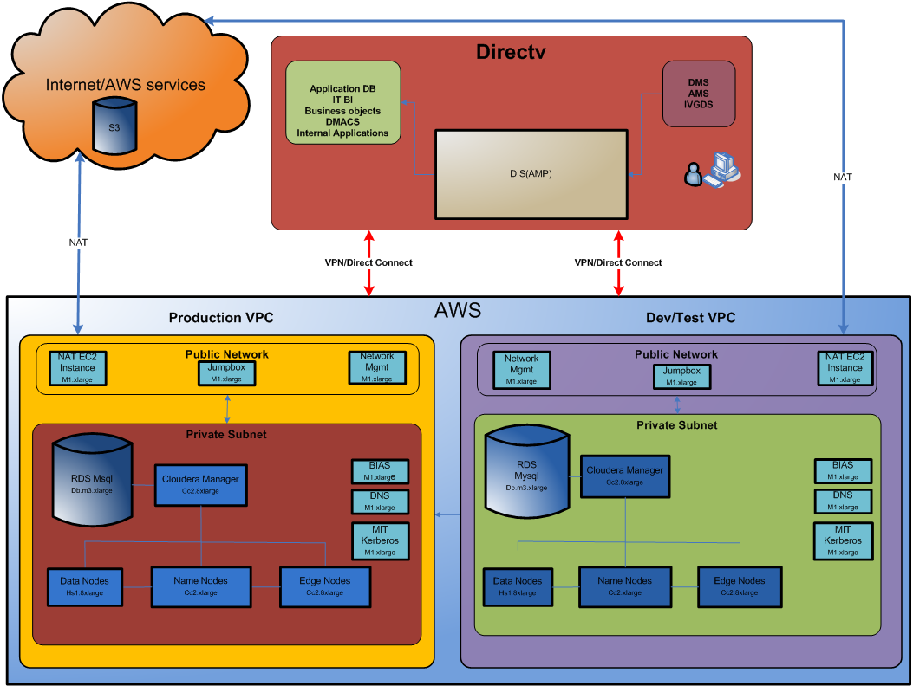
NSA Infrastructure
Preview of Cloudera on AWS Cloud

Slide 107
NSA Infrastructure
Requirements for Recommendations 2014
Infrastructure for Cloudera Hadoop(AWS) E2E/Test
Data Nodes– 5 nodes with the following configuration
hs1.8xlarge 16vCPU, 117GB RAM 24 X 2TB Disk 10Gb Network
Name Nodes – 3 nodes with the following configuration
cc2.8xlarge 32vCPU, 60.5GB RAM 4 X 480Gb Disk 10GB Network
Cloudera Manager – 1 node with the following configuration
cc2.8xlarge 32vCPU, 60.5GB RAM 4 X 480GB Disk 10Gb Network
Edge Node – 4 nodes with the following configuration
cc2.8xlarge 32vCPU, 60.5GB RAM 4 X 480GB Disk 10Gb Network
Database – Mysql 1 VM with the following configuration
db.m3.xlarge 4vCPU, 15GB RAM, Disk??, High Network Performance
DNS, BIAS, MIT Kerberos, Jumpbox and network management -- 10VMs with the following configuration.
m1.xlarge 4vCPU, 15GB RAM 4X420GB Disk 1Gb Network

Slide 108
NSA Infrastructure
Requirements for Recommendations 2014
Additional Requirements
Integrate these services to Hadoop
Omniture, CDN manager, PPV data from IT/BI
Requires ftp/stage server
Use existing BPN ftp server and mount 300GB NAS for storage.
1 VM – Configuration 1vCPU, 2GB and NAS storage for cron to scp the data.
Guide Data, UP-GVH, Social Data, Search History
Data Ingestion/Service Layer
Change to existing service – No info available
Hadoop
HDFS and HDFS together – Storage 5TB

Slide 109
NSA Infrastructure
Requirements for Recommendations 2014
Additional Requirements
Integrate these services to Hadoop continue
Digital Smith
Requirements???
Recommendation Services in POPs
Still being designed.
Cache unknown
Log requirements unknown
Requirements are not available.
ListBuilder
Requirements not available

Slide 110
NSA Infrastructure
Requirements for Recommendations 2014
Additional Requirements
Data Access/distribution Layer requirements
2 VMs in AWS with the following.
8GB RAM, 80GB Disk space, CPU??
Load Balanced VIP

Slide 111
Network and Systems Architecture
Storage and Network Architecture
Shaijo Mohan
May 27 2014

Slide 112
Agenda
Introduction
System Architecture and Network Connectivity Diagrams
Architecture for Hadoop deployment in AWS
Preliminary Data Growth Estimates

Slide 113
Business Need and Scope
Recommendations Near Term (2014)
What's popular (popular across all DIRECTV platforms)
Household based recommendations (personalized)
Platforms
Mobile/Dotcom using REST APIs
STB using RAS/APG
Compute “What’s Popular” with in DIRECTV
Use CDN data to compute what's popular with in DIRECTV, this covers all our client devices such as BB Connected STB, Mobile and Dotcom
Use Omniture data, this covers activity on Mobile and Dotcom
Use AMS / DMS data to compute popular live channels
Smart scheduling of carousel titles based on popular CDN downloads
Target: Mobile, Dotcom, STB
Core Recommendation
Household (account level) recommendation engine using Digital smith
Use CDN Manager logs containing STB Card Info to find account level activity
Use Mobile PPV data from omniture to find account level activity
Use Dotcom PPV data from omniture to find account level activity
Target Mobile and Dotcom
Influence voice search results

Slide 114
Scope of work -contd
Core Recommendation (Continued)
Enhance RAS (Recommendation Authoring System) by using Digital smiths similarity data
RAS could use Digital smiths similarity for better results
Target connected and non-connected STB
Personalized movie recordings from carousel and linear
Provide most relevant recommendations per timeslot / client for MYDIRECTV
Infrastructure
Hardware: AMS 100% call back. 8 Million out of 12 Million by March 2014
Software: VDDS / VDCS Migration by June 2014
Enables feedback loop with STBs, which in-turn strengthens core recommendations

Slide 115
Use cases traffic and capacity assumptions
What's popular
Definition of what's popular
The How
Structure of the incoming data (csv, xml, binary)
Frequency of the incoming data (daily)
Volume of incoming data ( > ~300G per day delta)
Actual processing of the data (Hadoop Tools)
How the output is going to be delivered to client devices
For phones, tablets and dotcom: Meta data delivery via REST
For phones, tablets and dotcom: Content delivery via CDN
For STB: Meta data delivery via APG
For STB: Content delivery using PSS Carousal
How fresh and relevant is this information to the end user (daily)
User feels informed about popularity charts
Capacity planning assumptions and projections
Year | 2012 | 2013 | 2014 | 2015 | 2016
Predicted DIRECTV authenticated portal users | 1,800,000 | 3,200,000 | 4,160,000 | 5,408,000 | 7,030,400

Slide 116
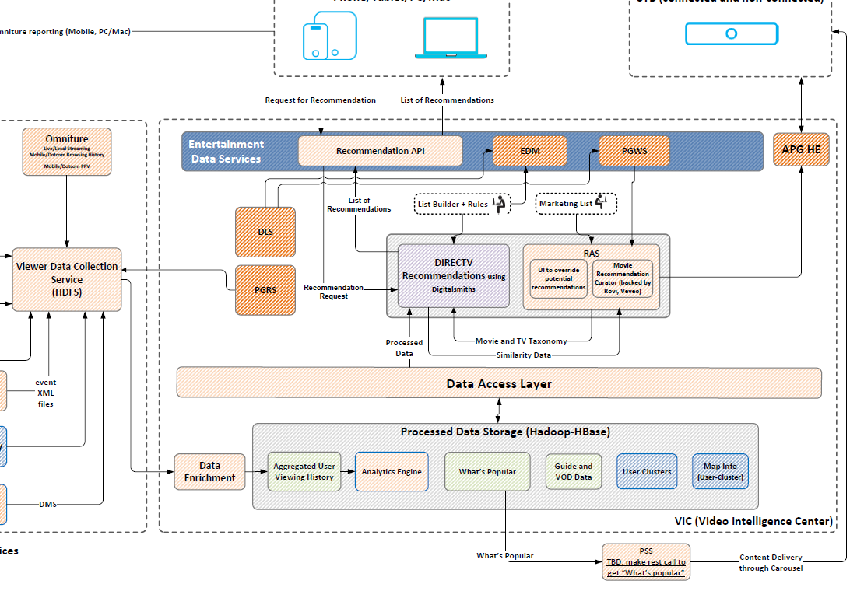
Key focus points for NSA network
4
6
3
5
1
2
7

Slide 117
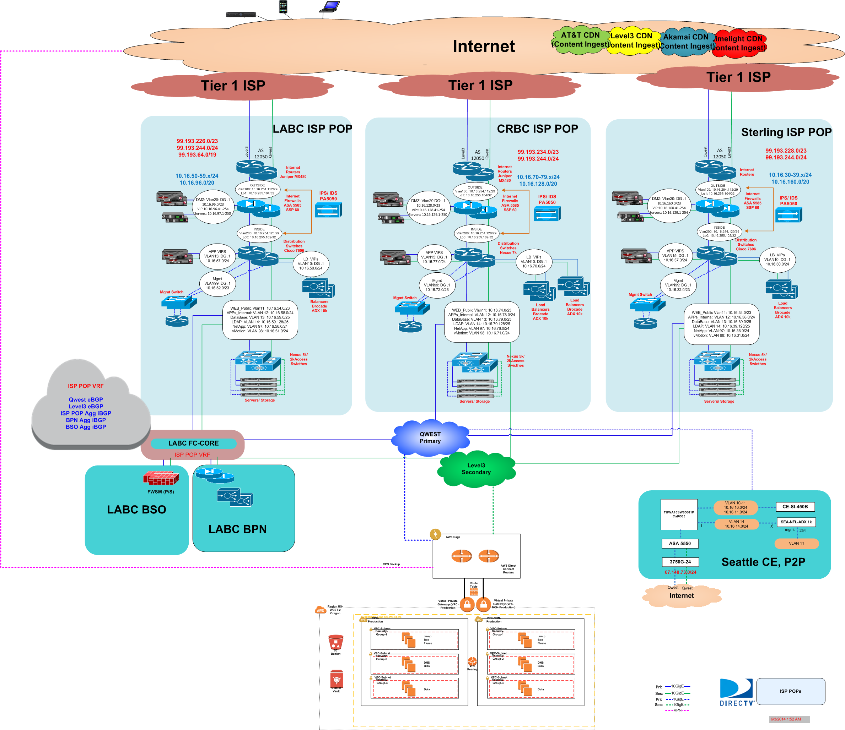
ISP POPs with AWS

Slide 118
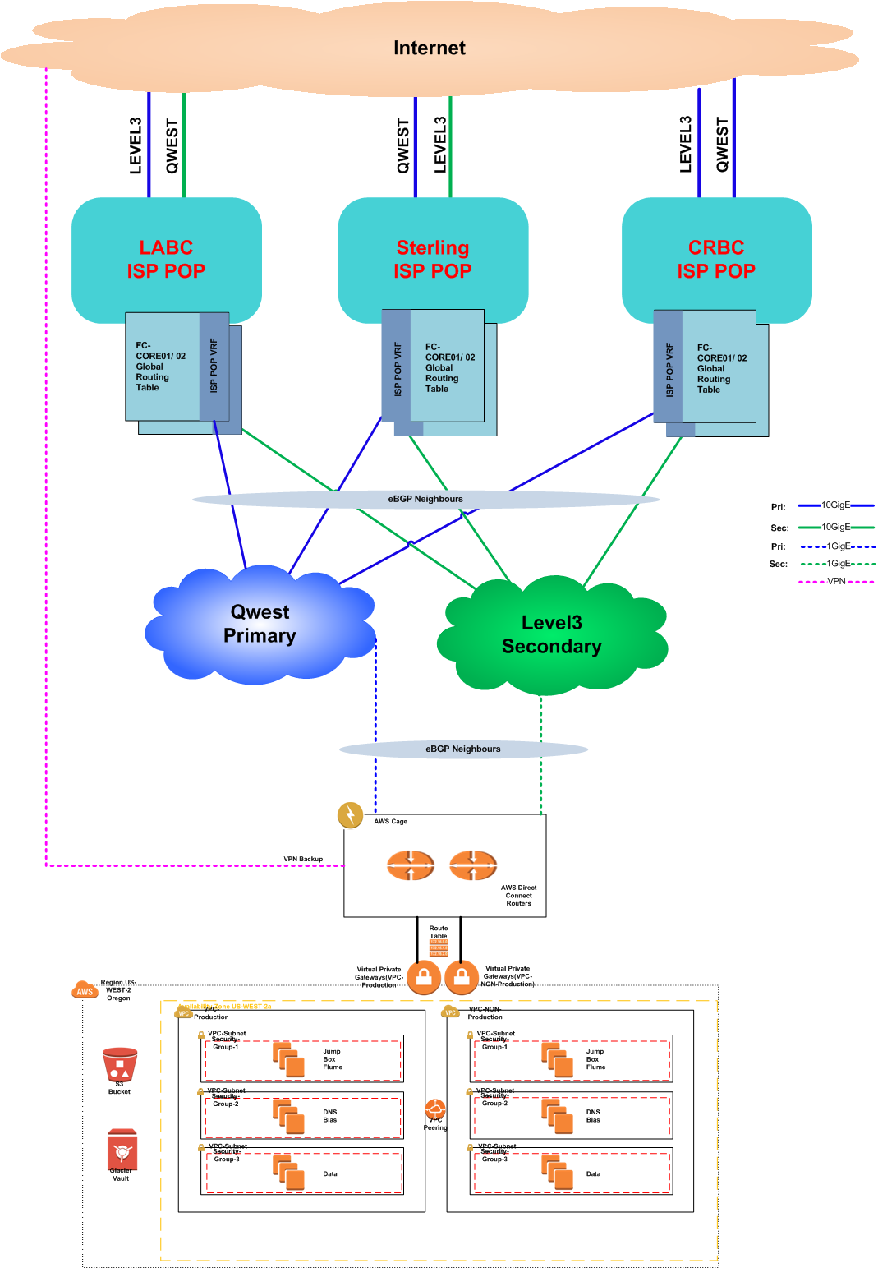
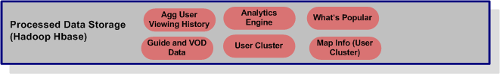
Recommendations – Network View

Slide 119
Cloudera on AWS
Requirements
Non-Production environment
Production environment
BIAS Integration
DNS Integration
Remote connectivity
Monitoring
Security

Slide 120
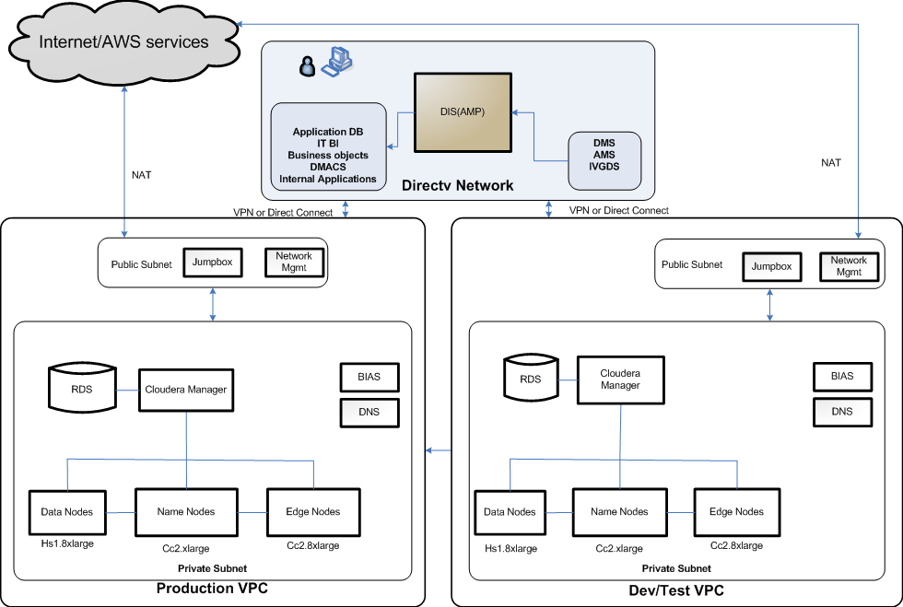
Cloudera on AWS – Reference Architecture
S3 Storage
MIT KERBEROS
MIT KERBEROS

Slide 121
Preliminary Data Growth Projections

Slide 122
Preliminary Data Growth Projections
Year | Initial+2015 | 2016 | 2017 | 2018 | 2019 | 2020
Reporting STB (Millions) |  | 12 | 14 | 16 | 18 | 20
IVGDS stb |  | 9 | 9 | 10 | 10 | 11
IVGDS GB/Day | 40000 | 105 | 129 | 154 | 181 | 210
DMS STB |  | 50 | 53 | 55 | 58 | 60
DMS GB/Day | 80000 | 600 | 735 | 880 | 1035 | 1200
AMS STB |  | 50 | 53 | 55 | 58 | 60
AMS GB/Day | 100000 | 600 | 735 | 880 | 1035 | 1200
Other Sources GB/Day |  | 130 | 137 | 143 | 150 | 156
Total TB/Day | 220.00 | 1.44 | 1.74 | 2.06 | 2.40 | 2.77
Archive Data | 66.00 | 0.43 | 0.52 | 0.62 | 0.72 | 0.83
Analysis Data | 66.00 | 0.43 | 0.52 | 0.62 | 0.72 | 0.83
Processed Data | 33.00 | 0.22 | 0.26 | 0.31 | 0.36 | 0.41
Big Data Requirements (TB) | 1271 | 3025 | 3657 | 4336 | 5060 | 5830
Aggregated Data/Year (TB) | 1271 | 4295 | 7953 | 12289 | 17349 | 23179
AWS Hadoop Nodes | 27 | 90 | 166 | 257 | 362 | 483

Slide 123
Proposed Network Connectivity Design
Use the Existing Backend MPLS connectivity to provide access to Hadoop in AWS
Provision 1GigE MPLS circuit from CenturyLink and Level3 to provide connectivity to AWS
Provide Temporary IPSEC VPN access over the Internet between DIRECTV and ASW to provide access to Hadoop
Review and finalize the single and multiple VPCs design within the DIRECTV container to provide separation between Prod and Dev Environment

Slide 124
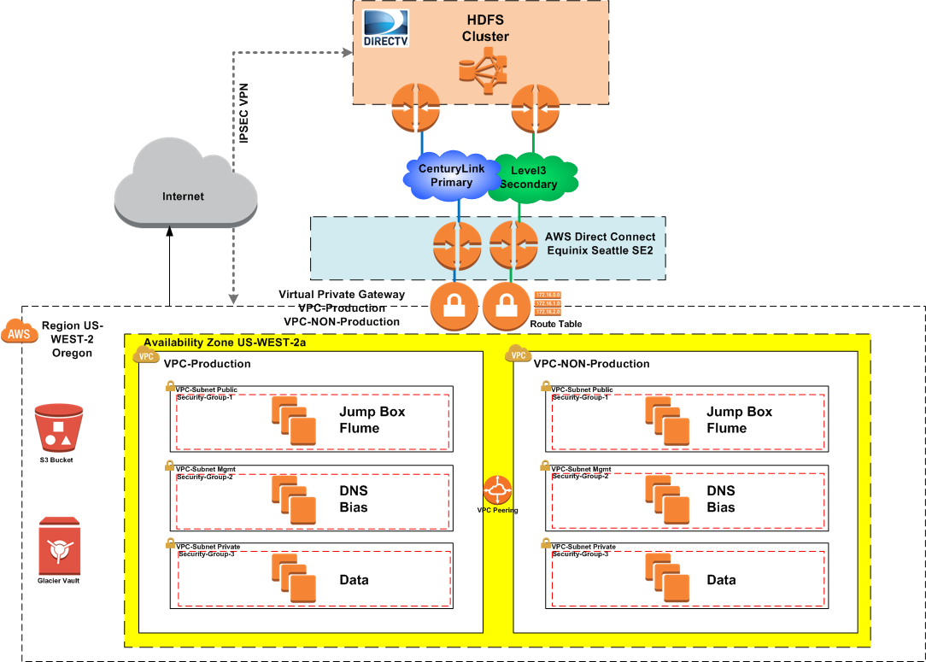
Proposed Network Connectivity Design

Slide 125
Q&A

